Slide 1
Philosophy of Religion: Arguments for God’s existence
Introduction to Philosophy
Philosophy 100
Class 3

Slide 2
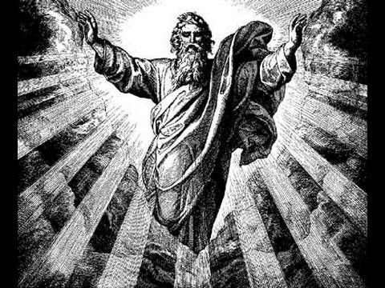
Overview
What do we mean by God?
There are four traditional arguments for God’s existence
The firs-cause Argument
The Cosmological Argument
The Teleological or Design Argument
The Ontological Argument
We will analyze each of these arguments today.

Slide 3
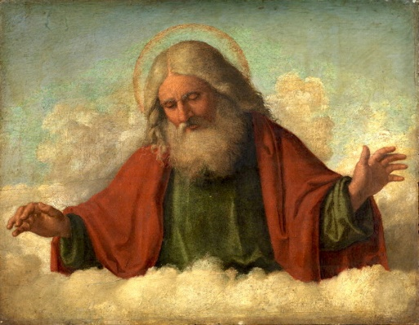
Characteristics of God
In the three main mono theistic religions, God is said to have the following characteristics:
Omnipotent – All Powerful
Omniscient – All Knowing
Omnibenevolent – All Good
Creator of the world

Slide 4
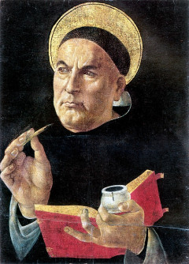
Thomas Aquinas (1225 – 1274)
Catholic Theologian and Philosopher
Worked within the Aristotelian tradition
His major work was Summa Theologica
Provides five proofs for God’s existence
Motion (Unmoved mover)
Efficient Cause (First Cause)
Contingency
Degree
Teleology

Slide 5
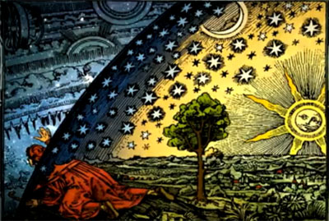
Cosmological Argument 1: First Cause
In the world we can see that things are caused.
It is not possible for something to be the cause of itself, because this would entail that it exists prior to itself.
If that by which it is caused is itself caused, then it too must have a cause.
There cannot be an infinitely long causal chain.
Therefore there must be a cause which is not itself caused by anything further.
The uncaused cause everyone understands to be God.

Slide 6
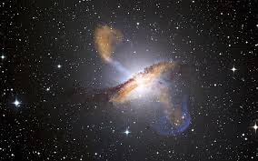
Cosmological Argument 2: The Argument from Contingency
In the world we see things that are possible to be and possible not to be.
If everything were contingent and thus capable of going out of existence, then, given infinite time, this possibility would be realized and nothing would exist now.
Things clearly do exist now.
Therefore, there must be something that is imperishable: a necessary being, which everyone understands to be God

Slide 7
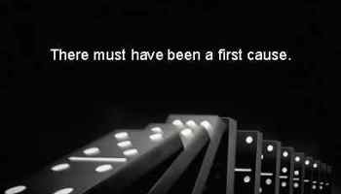
The Basic Structure of the Cosmological Argument
Every event must have a cause.
There cannot be infinite number of actual events.
Thus, there must be a first cause.
Therefore God exists.

Slide 8

Challenge to the Cosmological Argument 1: Why not infinity?
This response denies the second premise of the basic argument.
Math and physics successfully employ the concept of infinity - ∞ - often.
There is no logical reason to think that there cannot be an infinite chain of events or a closed causal loop that continues, from our perspective, forever.

Slide 9
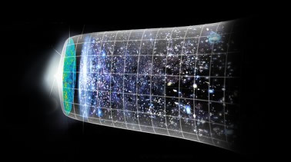
Challenge to the Cosmological Argument 2: Why must God be the first cause?
This response rejects the relevance of the premises to the conclusion.
Explaining the first cause by inferring that it must be God can be challenged by presenting alternative and equally plausible explanations.
Big bang
If God can be self-caused, why can’t the world be self caused?

Slide 10

The Teleological/Design Argument
Things in nature function for some purpose: the eye to see, leave to acquire nutrients for plants, etc.
Things in nature are highly complex and sophisticated in achieving their functions.
If complexity and purpose driven functions are part of organisms incapable of choosing their design and purpose, then the design and function must be provided by some designer.
God is that designer.
Therefore, God exists.

Slide 11
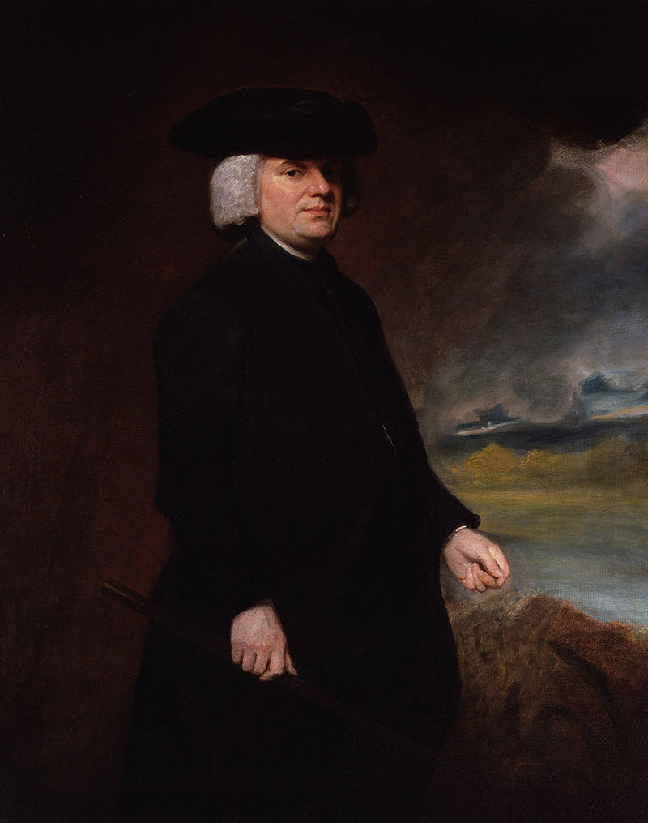
William Paley (1743 – 1805)
An English clergyman, Christian apologist, philosopher, and utilitarian.
Best known for his natural theology exposition of the teleological argument for the existence of God in his work Natural Theology or Evidences of the Existence and Attributes of the Deity, which made use of the watchmaker analogy.

Slide 12
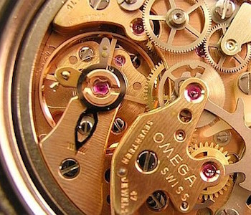
The Watchmaker Analogy
You’re walking along the beach one day and notice a watch in the sand. Suppose we don’t know that it is a watch at first, but after inspecting it we recognize that it’s a type of watch we’ve never encountered before.
Paley asks us: When you see the watch, do you infer that it simply emerged from chance in the sand or that someone dropped it there?
We assume someone has dropped it because it has a specific purpose and has a very complex design suited to achieving that purpose.

Slide 13
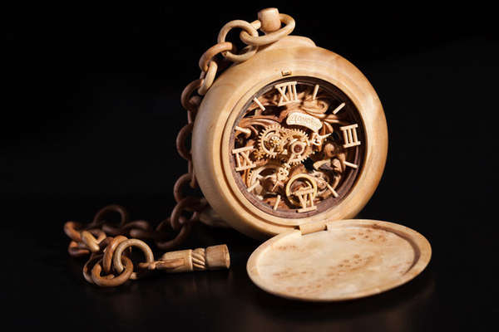
Assessing the Analogy
Analogue: Watch
Complex
Characteristics that seem specifically suited to it’s goals
Has a maker.
Primary Subject: Things in nature
Complex
Characteristics that seems specifically suited to survival.
Conclusion: Things in nature have a creator.

Slide 14
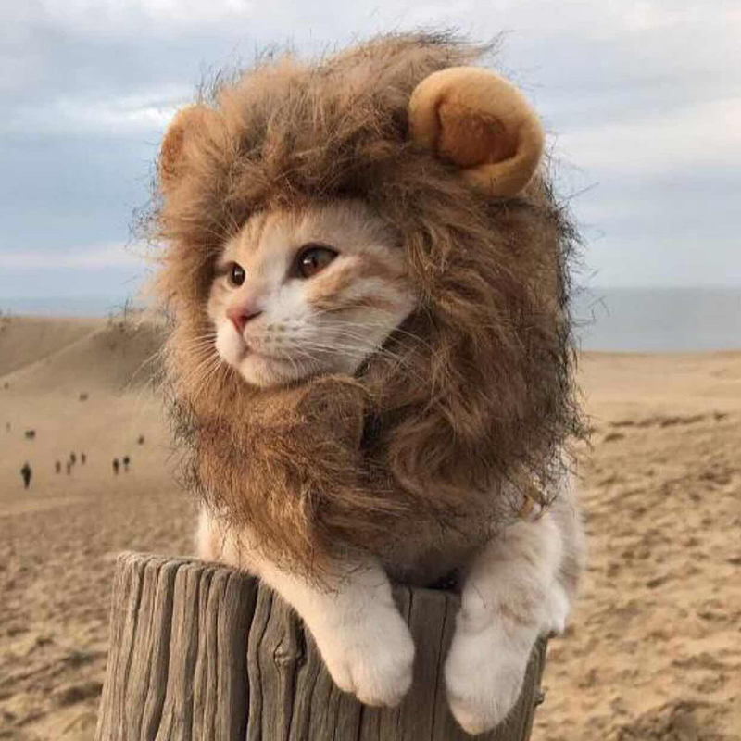
Challenges to the Design Argument
The Faulty/Weak Analogy Fallacy
An analogy that is so loose and remote that there is virtually no support for the conclusion.
The universe/nature is complex like a watch.
A watch has a designer.
Therefore, nature has a designer.
Similar Analogy
A kitten is like a lion.
Lions roar.
Therefore, kittens roar.

Slide 15
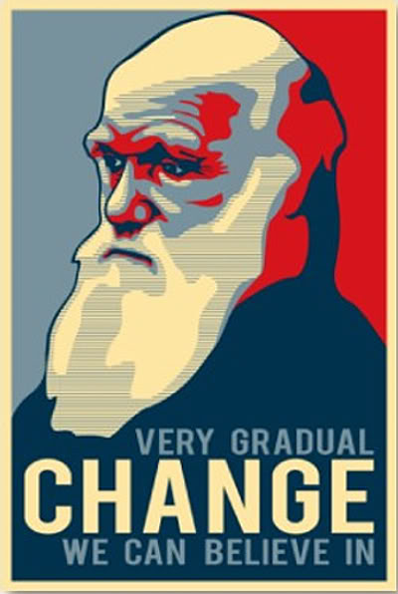
Bigger Challenge the Design Argument
It assumes a teleological explanation for the complexity in nature.
Teleology:
the explanation of phenomena by the purpose, function, or end they serve rather than by postulated causes.
Teleology takes a “top-down” approach to explanation. But we now know, since Darwin’s discovery in biology that this get the order of explanation the wrong way round.
Things in nature adapt to their surrounding or die; they are not designed to function towards some ultimate end.

Slide 16
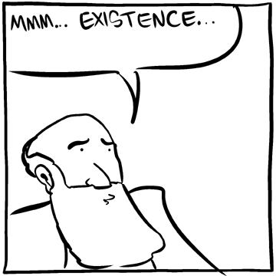
The Ontological Argument
God is that being of which nothing greater exists—God is a perfect being.
A perfect being’s nature/essence is complete in every way—a being that lacks no attributes.
Since we have the idea of a perfect being, that being must exist otherwise s/he would lack the attribute of existence.
Therefore God exists.

Slide 17
Criticisms of the Ontological Argument
Aquinas:
Only God could make this argument because only God is in a position to understand his own essence. The ontological argument would only be meaningful to someone who understands the essence of God.
Hume:
The contradiction of any matter of fact is possible. Nothing is demonstrable, unless the contrary implies a contradiction. Nothing, that is distinctly conceivable, implies a contradiction. Whatever we conceive as existent, we can also conceive as non-existent. There is no being, therefore, whose non-existence implies a contradiction. Consequently there is no being, whose existence is demonstrable. (Dialogues Concerning Natural Religion)
Russell:
…the essence of a person can be described and their existence still remain in question. (HWP)

Slide 18
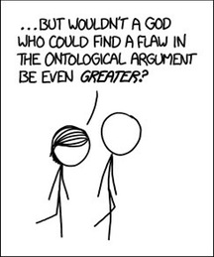
The BIG Problem for the Ontological Argument
Kant:
Existence is not a predicate. It is not an attribute that we give to something.
Put another way: stipulating that something, call it X, exists, does not change anything about what it means to be X.
What new attribute are we giving to the meaning of the term “triangle” to say it exists. Triangles are necessarily—in essence—a three sided geometrical shape. Adding “that exists” is adding nothing to what we mean by triangle.

Slide 19


